Slide 1
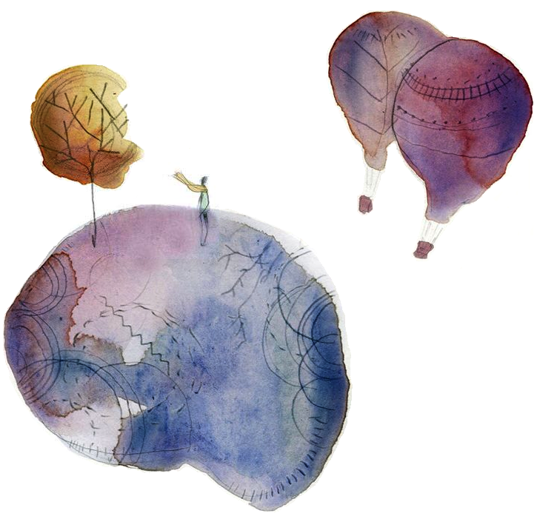
Dynamical modelling from resting-state brain imaging
University of Liège
Faculty of Applied Sciences
Department of Electrical Engineering and Computer Science
PhD Defense of Raphaël LIÉGEOIS
University of Liège - September 23, 2015

Slide 2
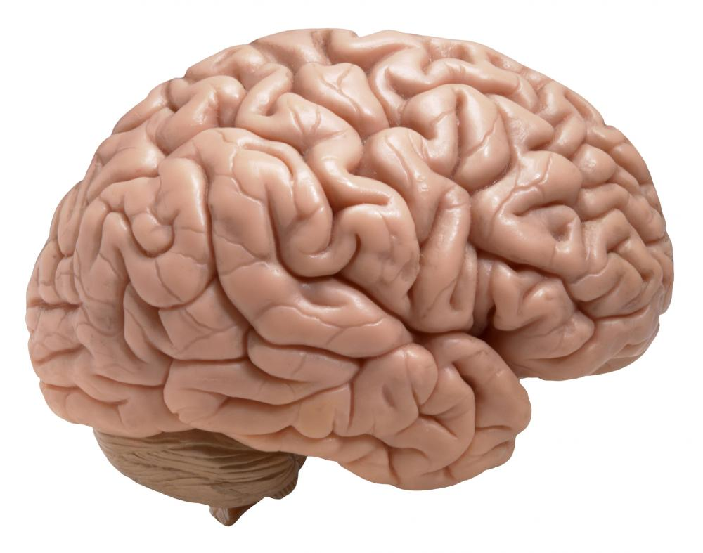
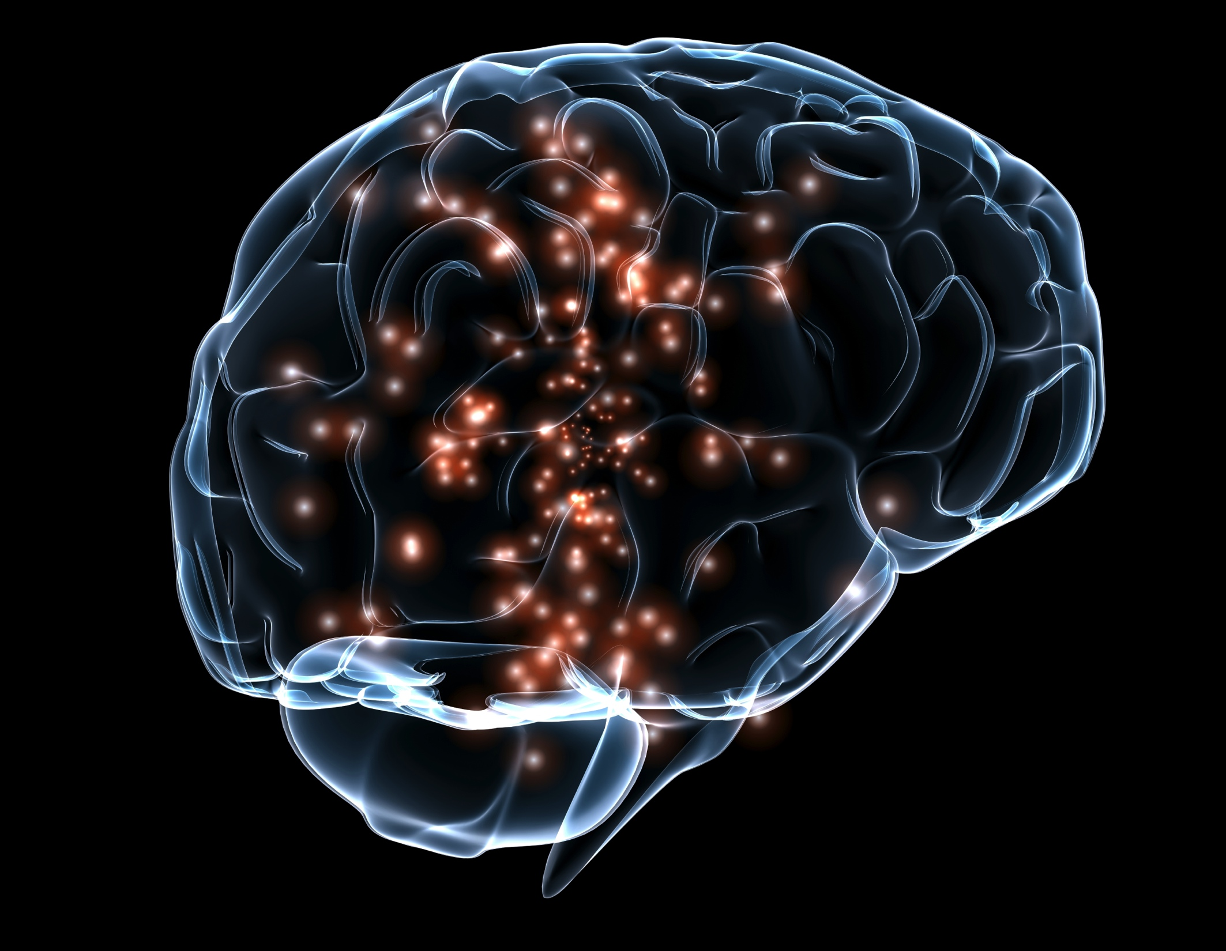
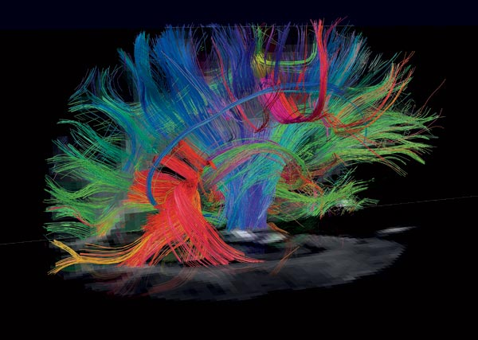
Introduction
Functional information
Anatomical information
Which mathematical representation ?

Slide 3
Introduction: anatomical information
Anatomical data (e.g. DWI)
Structural connectivity (SC) matrix
ROIs
ROIs

Slide 4
Introduction: functional information
Functional data (e.g. fMRI, EEG)
Functional connectivity (FC)
“Statistical dependence between two time series” (Friston, 2011).
FC matrix
Intensity in different ROIs
ROIs
Classically measured by the correlation between time series.
Time
ROIs

Slide 5
Introduction: motivating limitation
Functional data (fMRI)
FC measured by the correlation
FC matrix
ROI
ROI
Time (N points)
ROI
ROI
N points
FC measured by the correlation does not take the temporal information into account
“Static” approach

Slide 6
Introduction: motivating limitation
“Static” approach
“Temporal” approach
(Allen et al., 2012; Hutchison et al., 2014)
Signal in different regions
Signal in different regions

Slide 7
Outline
Role of anatomy in functional connectivity fluctuations
First markers of dynamical functional connectivity
New dynamical framework for analyzing functional connectivity
Perspectives and conclusions

Slide 8
Outline
Role of anatomy in functional connectivity fluctuations
First markers of dynamical functional connectivity
New dynamical framework for analyzing functional connectivity
Perspectives and conclusions

Slide 9
Does anatomy predict FC fluctuations ?
14 subjects
Functional (fMRI) data: 300 time points corresponding to 600 sec acquisitions (TR=2sec)
Anatomical (DWI) data
Resting-state acquisitions

Slide 10
Does anatomy predict FC fluctuations ?
FC(t) matrices using sliding windows of width w
(Temporal) FC(t)-SC link
Time (sec)
SC matrix
Are these fluctuations encoding temporal information ? What is the role of w ?
What is the interpretation of these fluctuations ?

Slide 11
Best value of w
Optimal window width: w ≈ [40-60] sec
(Liégeois et al., Brain Structure & Function, 2015)

Slide 12
Interpretation of the fluctuations
(Temporal) FC(t)-SC link
Argument 1
Argument 2
F*
Time (sec)
Frequency (Hz)
We argue that R_{t} results from consciousness-related processes based on three arguments (Liégeois et al., Brain Structure and Function, 2015):
1 – Spectral properties of R_{t}, in particular F* (Vanhaudenhuyse et al., 2011)
2 – Modularity and efficiency properties of FC(t) reflect alternation between states of external and internal awareness (Doucet et al., 2012)
3 – Spatial distribution of contributions to R_{t} (DMN and EXN are the most involved)

Slide 13
Conclusions
Identification of the optimal window width (w ≈ [40-60] sec) for sliding window approaches.
Role of anatomy in fluctuations of functional connectivity patterns
Io
O
We consider here the temporal evolution of a static measure of functional connectivity, is this the best approach ?
For more details, see:
R. Liégeois, E. Ziegler, C. Phillips, P. Geurts, F. Gómez, M. Ali Bahri, T. Yeo, A. Soddu, A. Vanhaudenhuyse, S. Laureys, and R. Sepulchre. Cerebral functional connectivity periodically (de)synchronizes with anatomical constraints. Brain Structure and Function, In press, 2015.

Slide 14
Outline
Role of anatomy in functional connectivity fluctuations
First markers of dynamical functional connectivity
New dynamical framework for analyzing functional connectivity
Perspectives and conclusions

Slide 15
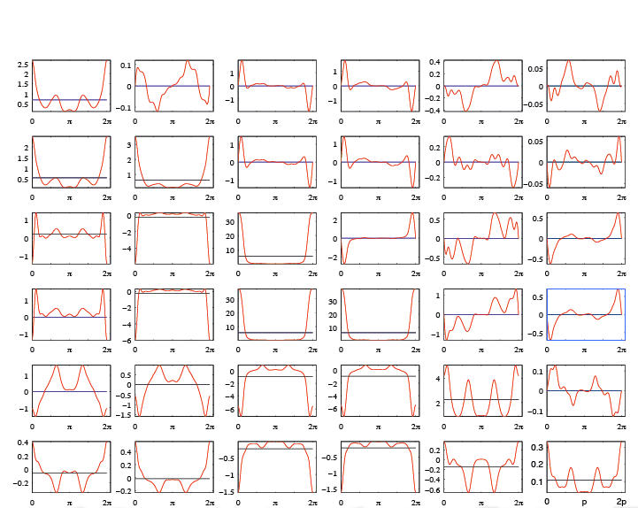
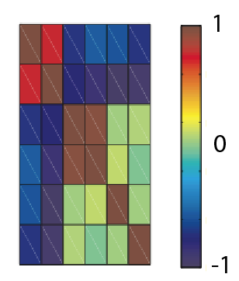
Static versus dynamic models
Starting from N observations :
Static models consider these observations as N realizations of a centered gaussian variable X entirely characterized by:
Dynamic models consider these observations as one realization of a centered gaussian process X_{t} entirely characterized by:
Functional data (fMRI)
ROI 1
ROI 2
or
ROI m
(N) samples

Slide 16
First order approximation of the PSD
First order approximation of the power spectral density:
where:
is a constant (static) contribution to the PSD
is a dynamic contribution to the PSD
.
.
≈ R₀
+ R₁

Slide 17
Spatiotemporal connectivity
For a set of m regions and corresponding time courses, we define spatiotemporal connectivity (STC) as the collection of the three following measures:
where:
σ_{s} is the average classical static correlation in the m ROIs,
σ_{d} is the average dynamic correlation in the m ROIs,
δ is the average first order auto-correlation in the m ROIs.

Slide 18
Dataset n°1
19 healthy volunteers undergoing four different states of consciousness:
W: wakefulness
S: mild sedation
U: unconsciousness
R: recovery of consciousness
Functional MRI time series extracted in four different networks:
Default mode network (DMN)
External control network (EXN)
Auditory network (AUD)
Visual network (VIS)
Computation of the three markers of spatiotemporal connectivity within the four networks

Slide 19
Results on dataset n°1
STC computed in four networks and states of consciousness
State of consciousness
Classically obtained
(e.g. Boveroux et al., 2010)
Additional information not obtained in classical static analyses

Slide 20
Conclusions
“Ordering” information is a built-in feature of the proposed markers through the dynamic underlying generative model.
Spatiotemporal connectivity can be seen as an extension of usual connectivity:
σ_{s} captures classical (static) connectivity,
σ_{d} can capture correlations between unsynchronized signals,
δ encodes information about internal memory of the network.
Io
O
We need prior information about which m regions should be chosen.
For more details, see:
R. Liégeois, M. Ali Bahri, M. Zorzi, S. Laureys, and R. Sepulchre. Dynamical properties of fMRI connectivity in neuronal networks mediating consciousness. Second Whistler Scientific Workshop on Brain Function, Whistler, Canada, 2014.

Slide 21
Outline
Role of anatomy in functional connectivity fluctuations
First markers of dynamical functional connectivity
New dynamical framework for analyzing functional connectivity
Perspectives and conclusions

Slide 22


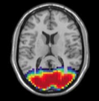
Low-rank approximation of functional connectivity
In static models, FC is measured by the correlation matrix of the data denoted Σ_{m,m}
where m can be large we need prior information about “where to look”.
One general framework to explore this is to compute a low-rank approximation of Σ_{m,m}:
Advantages
Reduce dimension
Easy neurological interpretation as the superposition of different networks:
DMN
SM
VIS
where:
c_{i} of size (m,1) is the i^{th} component,
α_{i} is the weight of the i^{th} component,
r is the rank of the approximation, or number of components.
Robust across subjects
Drawback
It is static

Slide 23
Our approach: graphical models
Definition
Interpretation of Φ⁻¹
A graphical model is defined by a set of nodes x={x₁,…,x_{n}} and edges such that there is an edge between x_{k} and x_{l} if and only if:
Φ(k,l) encodes statistical dependencies between x_{k} and x_{l} whereas Φ⁻¹(k,l) encodes statistical dependencies between x_{k} and x_{l} conditioned on all the other variables:
The corresponding graphical model is:

Slide 24
Which graphical model for fMRI data ?
fMRI data
Which graphical model ?
ROI 1
(2) Latent variables
ROI 2
ROI m
Manifest variables
Time
We want:
The manifest (observed) variables to be modeled as the superposition of few latent (hidden) variables.
We w
Few connections within the manifest variables.
We w
No connections within the latent variables.

Slide 25
Structure of Φ⁻¹
Considering:
l latent variables
m manifest variables (m>>l)
,
we have:
The identified inverse power spectral density should be the sum of a sparse and a low-rank term
encodes the weight of each latent variable in each manifest variable

Slide 26
Definition of latent components
The i^{th} latent component of a graphical model, with i ≤ l, is the i^{th} column of .
It is denoted γ_{i,.}(θ),
It is a function of θ when p>0.
When m is too large, and for p=1, we define two contributions: γ₀ = γ(θ=0) and γ_{π} = γ(θ=π).

Slide 27
Corresponding optimization problem
The corresponding optimization is a regularized covariance selection problem (Zorzi and Sepulchre, 2015):
where:
m is the number of (manifest) variables,
p is the number of lags considered,
C is a matrix containing the sample covariance lags ,
the weighting parameters γ>0 and λ>0 enforce sparse S and low-rank L.
Solved using the Alternating Direction Method of Multipliers (ADMM - Boyd et al., 2011) in order to decouple the sparse and low-rank constraints:
the sparse constraint reduces to a separate problem solved in Songsiri and Vandenberghe, 2010
the low-rank constraints is detailed in Liégeois et al., CDC 2015.
The Matlab implementation of the algorithm is available from the webpage http://www.montefiore.ulg.ac.be/~rliegeois/.

Slide 28
Dataset n°1
Synthetic dataset composed of time courses in 7 nodes organized in two coupled clusters, sampled at three different rates: original, T₁, and T₂ :
For each of the three datasets, and for p=0 (static case) and p=1 (dynamic case), we identify the optimal S+L model and corresponding latent components.

Slide 29
Results on dataset n°1
In the static case, we identify two latent components, similar for each dataset.
In the dynamic case, one single latent component is identified that also encodes spectral information of the dataset.

Slide 30
Dataset n°2
17 healthy volunteers
Functional (fMRI) data acquired during rest in 90 regions of interest
If principal component analysis is applied, we recover the three following networks:
For each subject, we compute the optimal S+L model and corresponding latent components for p=1 (dynamic case).

Slide 31
Results on dataset n°2
Among the 10 to 12 latent components identified:
the Visual network is identified in 14 out of 17 subjects in a single latent component,
the DMN and EXN are identified in 12 out of 17 subjects, almost each time coupled to each other within a same latent component.

Slide 32
Conclusions
Using the ADMM framework, we efficiently solve the S+L graphical model identification problem.
Dynamic latent components recover spatio-temporal properties of the original time series.
Novel characterization of the interplay between the DMN and the EXN.
For more details, see:
R. Liégeois, B. Mishra, M. Zorzi, and R. Sepulchre. Sparse plus low-rank autoregressive identification in neuroimaging time series. 54th IEEE Conference on Decision and Control, Osaka, December 2015.

Slide 33
Outline
Role of anatomy in functional connectivity fluctuations
First markers of dynamical functional connectivity
New dynamical framework for analyzing functional connectivity
Perspectives and conclusions

Slide 34
Take-home messages
1. The interplay between anatomy and function is essential to understand brain dynamics.
2. Dynamical models of connectivity generalize classical (static) measures of connectivity.
3. Latent components of graphical models capture a spatiotemporal subspace of variation.
FC(t)-SC link
.
.
≈ R₀
+ R₁
Time (sec)

Slide 35
Perspectives
1. Explore the anatomical and functional counterparts of consciousness.
2. Include specific information about the nature of the fMRI signal.
3. Establish a mathematical link between latent components and component t analysis which could lead to “dynamical component analysis”.

Slide 36
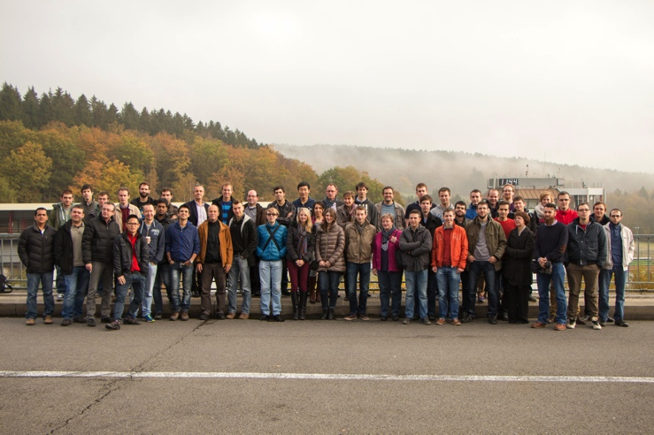
Thank you
My colleagues,
Bamdev Mishra
Mattia Zorzi
Julie Dethier
Alexandre Mauroy
Guillaume Drion
Fulvio Forni
Pierre Sacré
Laura Trotta
Alessio Franci
at CRC/CSG,
>>Enrico Amico☺<<
Yorgos Antonopoulos
Lizette Heine
Mohamed Ali Bahri
Jessica Schrouff
Carol Di Pierri
at Montefiore,
Ramouna Fouladi
François Van Lishout
Kirill Bessonov
and office mates.
Marie Wehenkel
Anne Collard

Slide 37
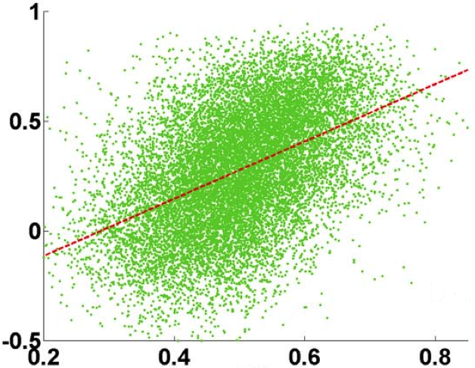
Does anatomy predict function ?
FC matrix
(Static) FC-SC link
R_{s}= corr(FC,SC)
= 0,48
FC
SC matrix
SC
(Honey et al., 2009)
Anatomy partly predicts function

Slide 38
Static vs. Temporal approach

Slide 39
Impact of the window width w
Observations
Increasing w tends to mask fluctuations
Remaining question
How do we assess the neuronal origin of these fluctuations ?
Solution
Use a surrogate (phase randomized) dataset comparison:
Static measures (e.g. R_{s}) are preserved
Temporal measures (e.g. R_{t}) are changed
Time (sec)

Slide 40
Impact of widow width

Slide 41
Test against surrogate dataset
Ordered case
Phase randomized case
How to discriminate between the ordered and phase randomized cases ?
Use V, the level of variation (max-min) of R_{t}
(also works with variance or spectral markers)

Slide 42
Test against surrogate data

Slide 43
R_{t} is a footprint of consciousness – argument 1
(Temporal) FC(t)-SC link
F*
Time (sec)
Frequency (Hz)
For w that best unveils dynamics of R_{t} (w = 40 sec), F* = 0.01 ± 0.003 Hz
This frequency range is experimentally observed in the interplay between internal and external awareness networks (Vanhaudenhuyse et al., 2011)

Slide 44
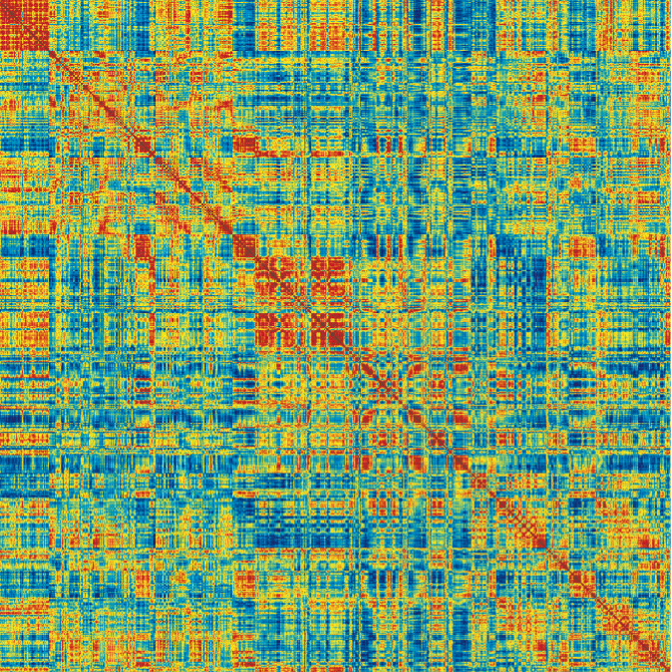
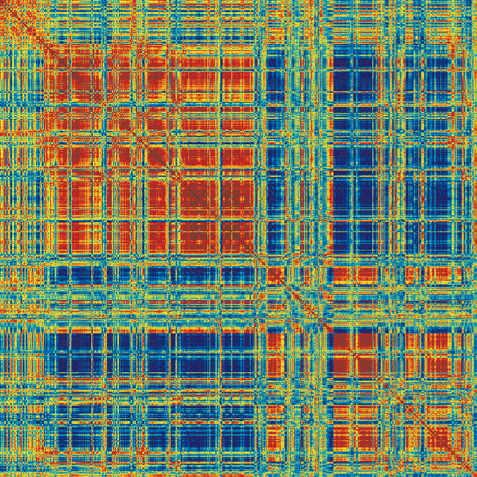
R_{t} is a footprint of consciousness – argument 2
FC during high R_{t}
Graph metrics of FC during phases of high and low R_{t}
(Temporal) FC(t)-SC link
Efficiency
Modularity
p<10⁻⁴
p<10⁻³
FC during low R_{t}
Low R_{t} High R_{t}
Low R_{t} High R_{t}
Time (sec)
Fluctuations of efficiency and modularity properties in FC(t) balance efficient information-processing and metabolic expenditure (Zalesky et al., 2014)
Mind wandering between internal and external awareness was also related to fluctuations of FC modular organization (Doucet et al., 2012)
Anatomy seems to guide this balance and transitions

Slide 45
R_{t} is a footprint of consciousness – argument 3
What are the contributions of each region in the global R_{t} measure ?
FC(t) matrices using sliding windows of width w
FC(t)-SC link in region i
Only consider i^{th} line
Time (sec)
SC matrix
And we get V in each region

Slide 46
R_{t} is a footprint of consciousness – argument 3
What are the contributions of each region in the global R_{t} measure ?
Left hemisphere Right hemisphere
DLPF | Dorso-lateral prefrontal cortex
SM | Sensory-motor
PCC | Posterior cingulate
MF | Mesio-frontal
ACC | Anterior cingulate
PH | Parahippocampal
VIS | Visual
DLPF | Dorso-lateral prefrontal cortex
SM | Sensory-motor
PCC | Posterior cingulate
MF | Mesio-frontal
ACC | Anterior cingulate
PH | Parahippocampal
VIS | Visual
Internal awareness (or “default mode”) network
External awareness network
Average V (%) over all subjects

Slide 47
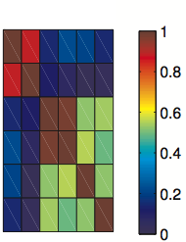
Static versus dynamic models
Functional data (fMRI)
Starting from N observations:
of an unknown phenomenon ,
static models consider that:
ROI 1
is a centered, gaussian random vector X
X takes values in
X is completely described by its correlation matrix
ROI 2
ROI m
(N) samples
(m=6)

Slide 48
Static versus dynamic models
Starting from N observations:
of an unknown phenomenon ,
dynamic models consider that:
Functional data (fMRI)
is a centered, gaussian, stationary, stochastic process
takes values in
is completely described by the covariance lags sequence:
ROI 1
ROI 2
through the power spectral density:
ROI m
(N) samples
(m=6)

Slide 49
First order approximation

Slide 50
Illustration of STC

Slide 51
Results on dataset n°1 using inverse PSD

Slide 52
Dataset n°2
31 patients with probable Alzheimer’s disease (AD) divided in two groups based on the MARS score (Clare et al., 2002):
15 “conscious” AD patients
16 anosognosic AD patients
Functional MRI time courses extracted in the default mode network (DMN)
Computation of the three markers of spatiotemporal connectivity within the DMN; only δ is used in the following.

Slide 53
Results on dataset n° 2

Slide 54
Results on dataset n°2
δ in DMN
MARS score
There is a significant correlation between δ in DMN and the MARS score
First time anosognosic AD patients could be distinguished from conscious AD patients based on fMRI data

Slide 55
Overview of our algorithm
Problem to be solved:
Problem 1: h is convex but non-smooth.
(Partial) Solution: when there is only the sparsity contraint, solve on the corresponding dual problem (Songsiri and Vandenberghe, 2010).
Problem 2: how to include the low-rank constraint ?
Solution: use the Alternating Direction Method of Multipliers (ADMM - Boyd et al., 2011) in order to decouple sparse and low-rank constraints (Liégeois et al., 2015).

Slide 56
Overview of our algorithm
ADMM for sparse plus low-rank inverse power spectral density estimation. Initialize Z⁰, Y⁰, M⁰; set ρ > 0; and successively update variables as follows:
where:
Y and Z are the dual variables,
M is the decoupling variable,
C₁ is a set corresponding to the sparsity constraint defined in Songsiri and Vandenberghe (2010),
C₂ is a set corresponding to the low-rank constraint (Liégeois et al., CDC 2015).
The Matlab implementation of the algorithm is available from the webpage http://www.montefiore.ulg.ac.be/~rliegeois/.

Slide 57
Convergence of ADMM

Slide 58
Application of S+L identification on synthetic data

Slide 59
Interaction graphs in neuroimaging data
B
Frontal
Occipital
Temporal

Slide 60
Generative model: Hopfield

Slide 61
Dataset n°2
Synthetic dataset composed of time courses in 7 nodes organized in two uncoupled clusters, sampled at three different rates: original, T₁, and T₂ :
For each of the three datasets, and for p=0 (static case) and p=1 (dynamic case), we identify the optimal S+L model and corresponding latent components.

Slide 62
Results on dataset n°2
In the static case, we identify two latent components, similar for each dataset.
In the dynamic case, two latent components are identified because the spectral properties of each cluster are different (uncoupled oscillators).

Slide 63
PCA on gaussian data

Slide 64
PCA on non-gaussian data

Slide 65
ICA on non-gaussian data

Slide 66
ICA on non-gaussian data

Slide 67
ICA on non-gaussian data

Slide 68
ICA on gaussian data

